Slide 1
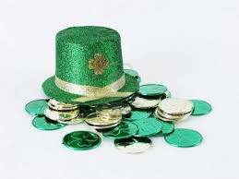
Connections Activity Leprechaun Traps
EcoVision Activity

Slide 2
Details:
Each Connections Class will get 2 classes to make and prepare their own Leprechaun traps. Each participating class will get supplies such as cardboard, popsicle sticks, string, and bait, but are able to bring any extra materials that they would like. The traps will be judged by asthetics as well as if they actually work! Prizes will be awarded to the best 3 traps and extra points will be awarded for using recycled materials!!!

Slide 3
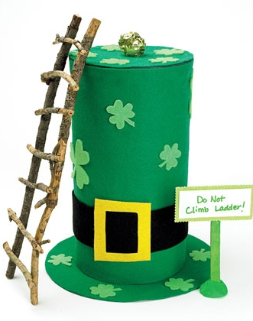
Trap Ideas
Leprechaun Hat Pit Trap
Leprechauns have big egos, so a giant version of their own hat is irresistible to them. Once they step on the false top, you'll have caught a 10-gallon prize.
So that the top doesn't give way too soon, use a lightweight bait, such as a crumpled piece of gold foil.
Our hat, a recycled oatmeal container, is wrapped with green felt secured with double-sided tape. To make the trap, we cut a hole in the lid (see image), then cunningly concealed it with a circle of green felt that will give way when the leprechaun steps on it.
Leprechauns love to break rules. Warning signs are sure to lure them in.
Natural materials make these woodland creatures feel at home. Our ladder is made from twigs held together with wood glue.
http://spoonful.com/crafts/catch-leprechaun

Slide 4
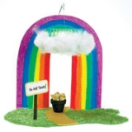
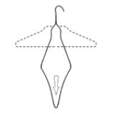
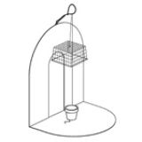
Trap Ideas
Rainbow Cage Drop
No self-respecting leprechaun can resist a giant rainbow. As he gets close and spies the gold bait, his curiosity will get the best of him. When he pinches the pot, down comes the cage!
A bent wire hanger hidden by a piece of poster board forms the support for the suspended cage. We bent the hook of the hanger into a loop to hold the line.
We tied fishing line to the top of a plastic berry basket, then threaded the line through the wire loop and back down through the basket. We pulled the line taut and secured it under the bait. To conceal the cage, we tucked fiberfill into the weave of the basket, giving it the look of a fluffy cloud.
http://spoonful.com/crafts/catch-leprechaun

Slide 5
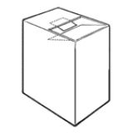
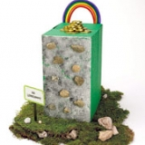
Trap Ideas
Tricky Trapdoor
This trap draws on time-honored technology: a swinging door cut into the top of the box gives way when the leprechaun tries to make off with the bait.
You can never have too many rainbows on your trap. This one is made from pipe cleaners.
For bait, try chocolate coins, shiny jewels, or even a worn-out doll shoe! (Leprechauns are cobblers by trade.) We glued the coins in a pile to keep them secure when the trap is sprung.
Our trapdoor is a flap held up by a tab of card stock (taped in place after the box is decorated).
This climbing wall is sure to entice the wee adventurers.
Ours consists of small rocks affixed with tacky glue to the sponge-painted box.
We covered our box with tissue paper (green, of course) attached with glue stick.
Capture the look of the Irish countryside with stones and bits of moss.
http://spoonful.com/crafts/catch-leprechaun

